Slide 1
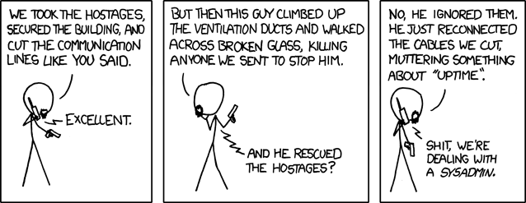
Systems and Networks Administration
“Devotion to duty” -Sysadmin
GIC 2022

Slide 2
Learning System Administration (Traditionally)
System Administration is a profession with no fixed career path.
No degree granting program
Heavy reliance on practical experience
Specialization in many different areas possible
Breadth of expertise as necessary as depth in some areas
Background knowledge and requirements vary

Slide 3
Learning System Administration (Traditionally)
Breadth of knowledge:
Operating system concepts
TCP/IP networking
Cloud computing
Programming
…
Depth of knowledge:
Certain OS flavor
Specific Service (DNS, Mail, Databases, Web, …
Specific implementation/vendor (Apache, Cisco, Oracle, …)
Specific area of expertise ( Security, storage, network, data center, ...)

Slide 4
Learning Objectives
Understand the jobs and responsibilities of a system admin.
Understand the issues involved in the design and management of a system network environment.
Applying existing knowledge of computer networking principles and concepts to build and administer a system or computer network.
Able to design, install and support a local area network based on established user requirements.

Slide 5
Assessment
Quiz/Homework: 10%
TP/Practical work: 30%
Midterm Test: 30%
Final Test: 30%
Bonus with class activities and participation in meetup tech event

Slide 6
Syllabus
Introduction to System Administration
Network and Infrastructure Services
Software and Platform Services
Directory Services
Data Recovery and Backups
Monitoring, Security and more later…

Slide 7
Learning methods
Learning is critical. How to find answers:
Know how to ask questions
Read more and more
Understand what you’re doing
Understand why you’re doing it
Seek information exchange
Know what you don’t know

Slide 8
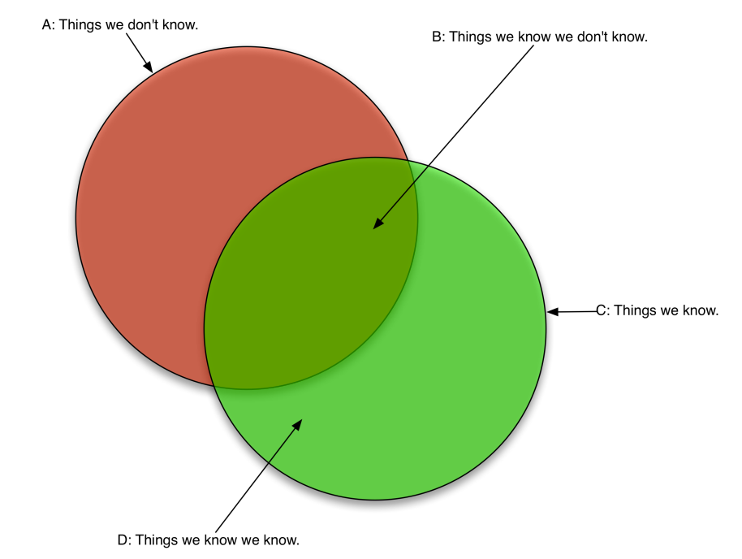
Learning methods: Dunning-Kruger effect

Slide 9
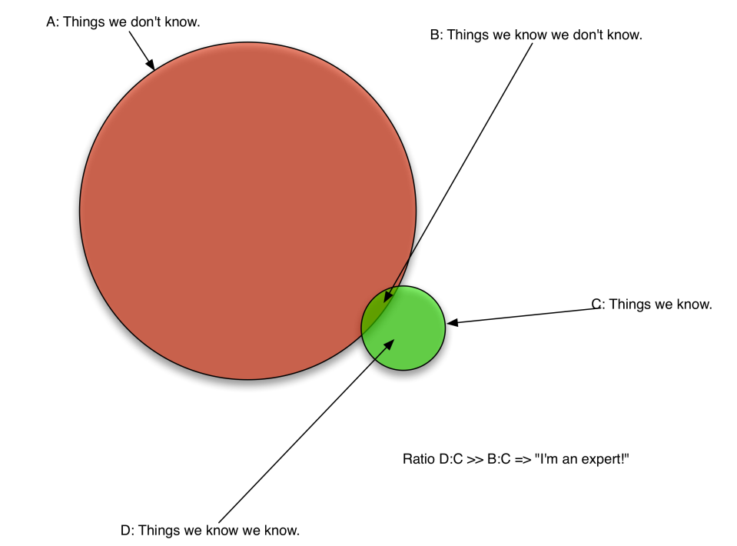
Learning methods: Dunning-Kruger effect

Slide 10
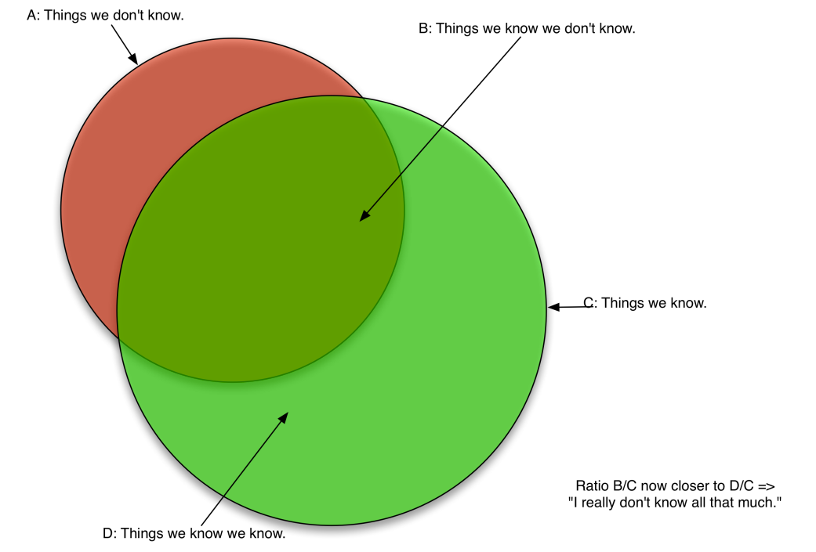
Learning methods: Dunning-Kruger effect

Slide 11
Lab Practice
VMWare Workstation/Virtual Box/VMWare Fusion
OS: Ubuntu Server and Windows Server
Check every week during beginning of lab session

